Slide 1
Placement
Workshop Session 5
Presented by
Hafiz Wajeh ul Hasan

Slide 2
Design.v, Design.sdc, Std_cells.lef, Std_cells.lib
Input
Synthesis
Yosys, OpenSTA
Design_gate_level_netlist.v
Output
Design_gate_level_netlist.v, macro.lef, macro.cfg
Input
Floorplanning/Power Network
init_fp, ioplacer, pdn
Floorplan.def
Output
Floorplan.def
Input
Placement
RePLace,OpenDP
Placement.def
Output
Open-source EDA Tools
Design_gate_level_netlist.v, Placement.def
Input
CTS
TritonCTS
CTS.def, CTS_netlist.v
Output
Input
Routing
FastRoute, TritonRoute
CTS.def
Routing.def
Output
Input
RC Extraction
SPEF-Extractor
Routing.def
Design.spef
Output
Input
GDS Generation
Magic
Input
Routing.def
Output
Output
Design.gds, Design.lef
Input
Physical Verification
APR Step
Design.gds
Magic
EDA Tool

Slide 3
Contents
Placement
Global Placement
Detailed Placement
Power connection of Standard Cells
Target Density
Macro/IP Placement
Macro/IP
Soft Macro/IP
Hard Macro/IP
LAB PRACTICE

Slide 4
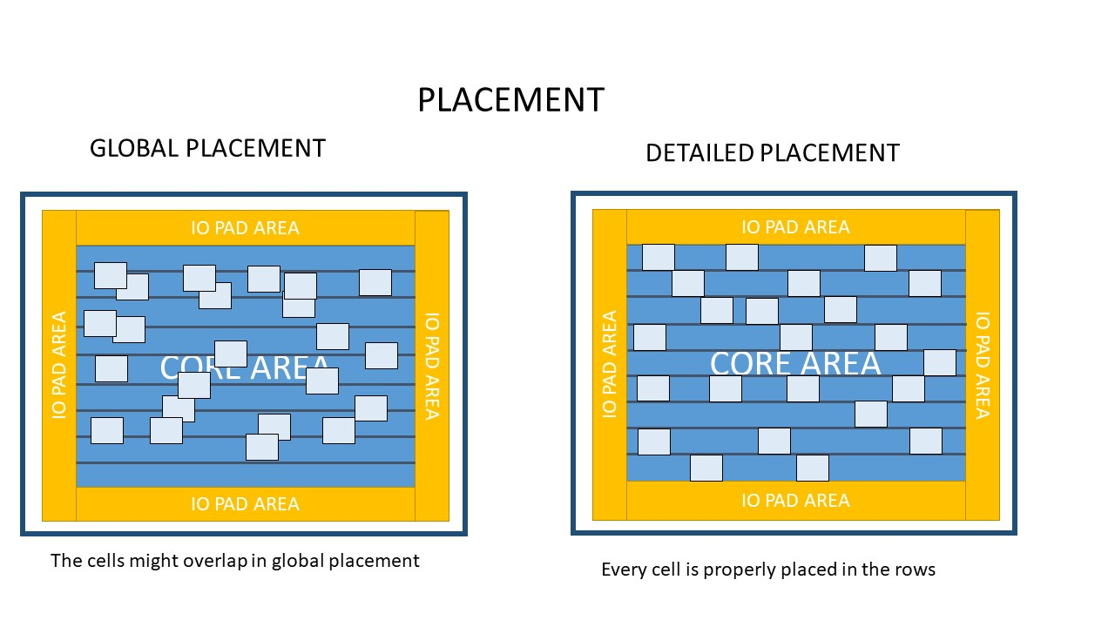
Placement
What is Placement?
Placement is the process of finding suitable location for each cell in the block
Placement of standard cells over the core area
Global placement
Detailed placement

Slide 5
Global Placement
Overlaps
Coarse placement of all the standard cells
Row intersection
IO PAD AREA
IO PAD AREA
CORE AREA
CORE AREA
Global Placement
IO PAD AREA
IO PAD AREA
IO PAD AREA
IO PAD AREA
IO PAD AREA
It tries to place cells closer which are connected to each other
IO PAD AREA

Slide 6
Detailed Placement
NO Overlaps
Legal placement of all the standard cells
NO Row intersection
IO PAD AREA
IO PAD AREA
CORE AREA
CORE AREA
Detailed Placement
IO PAD AREA
IO PAD AREA
IO PAD AREA
IO PAD AREA
IO PAD AREA
IO PAD AREA

Slide 7
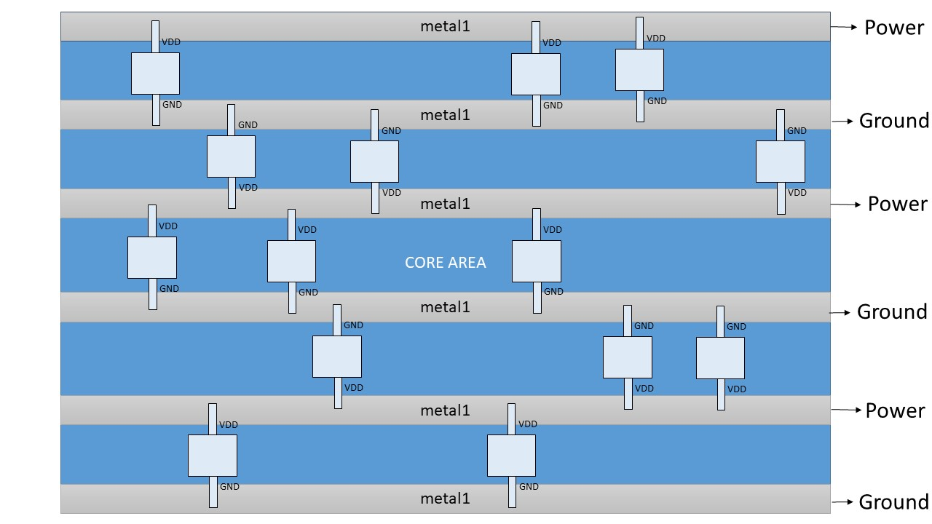
Power Connection of Cells
Flipped Standard Cells

Slide 8
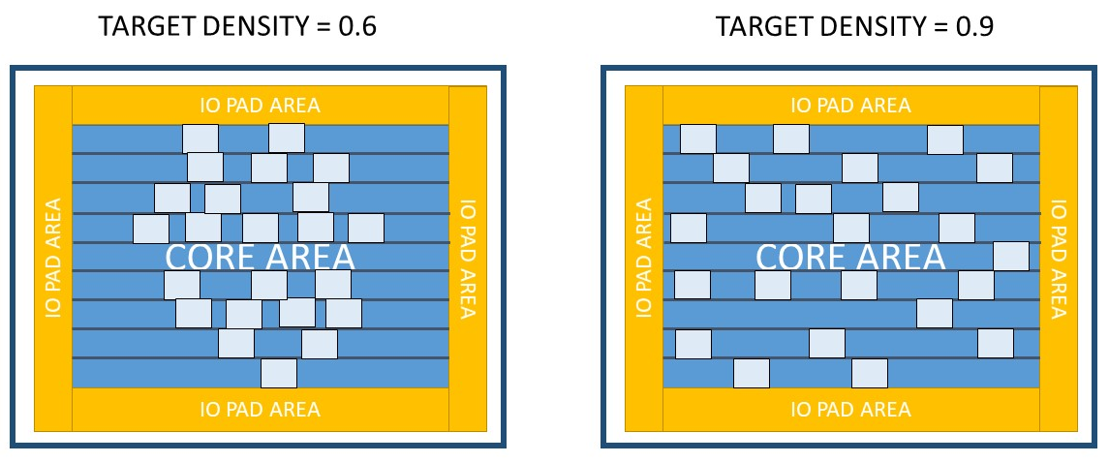
Target Density
The above comparison is a rough estimate

Slide 9
Macro/IP Placement
It is an intellectual property
Not your own work, but you have bought it from someone to use it in your design
Two major types
Soft Macro/IP
RTL
Hard Macro/IP
Hardened Macro [ A black box with only freedom to flip rotate ]
Blackbox
You don’t know what’s inside

Slide 10
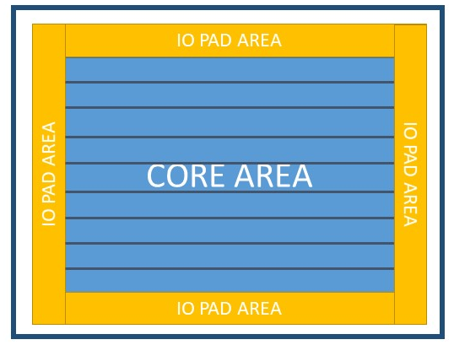
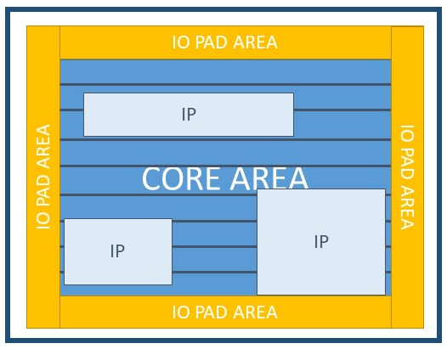
Macro/IP Placement
Using hard macros in the design
Assuming 3 macros are used

Slide 11

Macro/IP Placement
We were assuming a height of standard cells equal to the rows
The size here is different
Our power network theory went down the drain

Slide 12

Macro/IP Placement
How to power these macros?
Power grid
How to restrict routing and placement of standard cells over the macros?
Blockages!
For blockages you define the macro area to be restricted

Slide 13
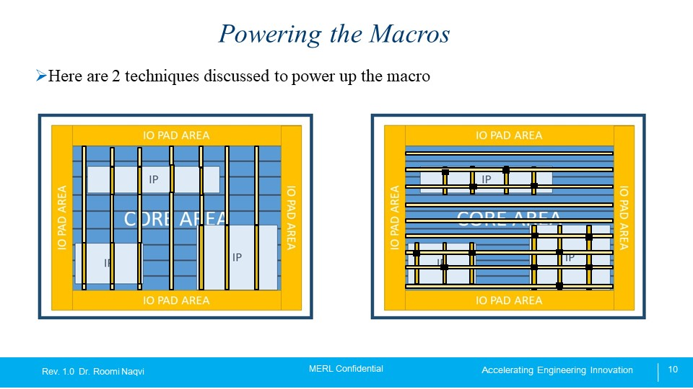
Powering the Macros
Here are 2 techniques discussed to power up the macro
Align the vertical straps of Macro to the core connecting them
Connect metal x of core to metal y of the macro through via

Slide 14
Key Point To Remember
Placement of macros should be done before the placement of standard cells
LAB PRACTICE

